Slide 1
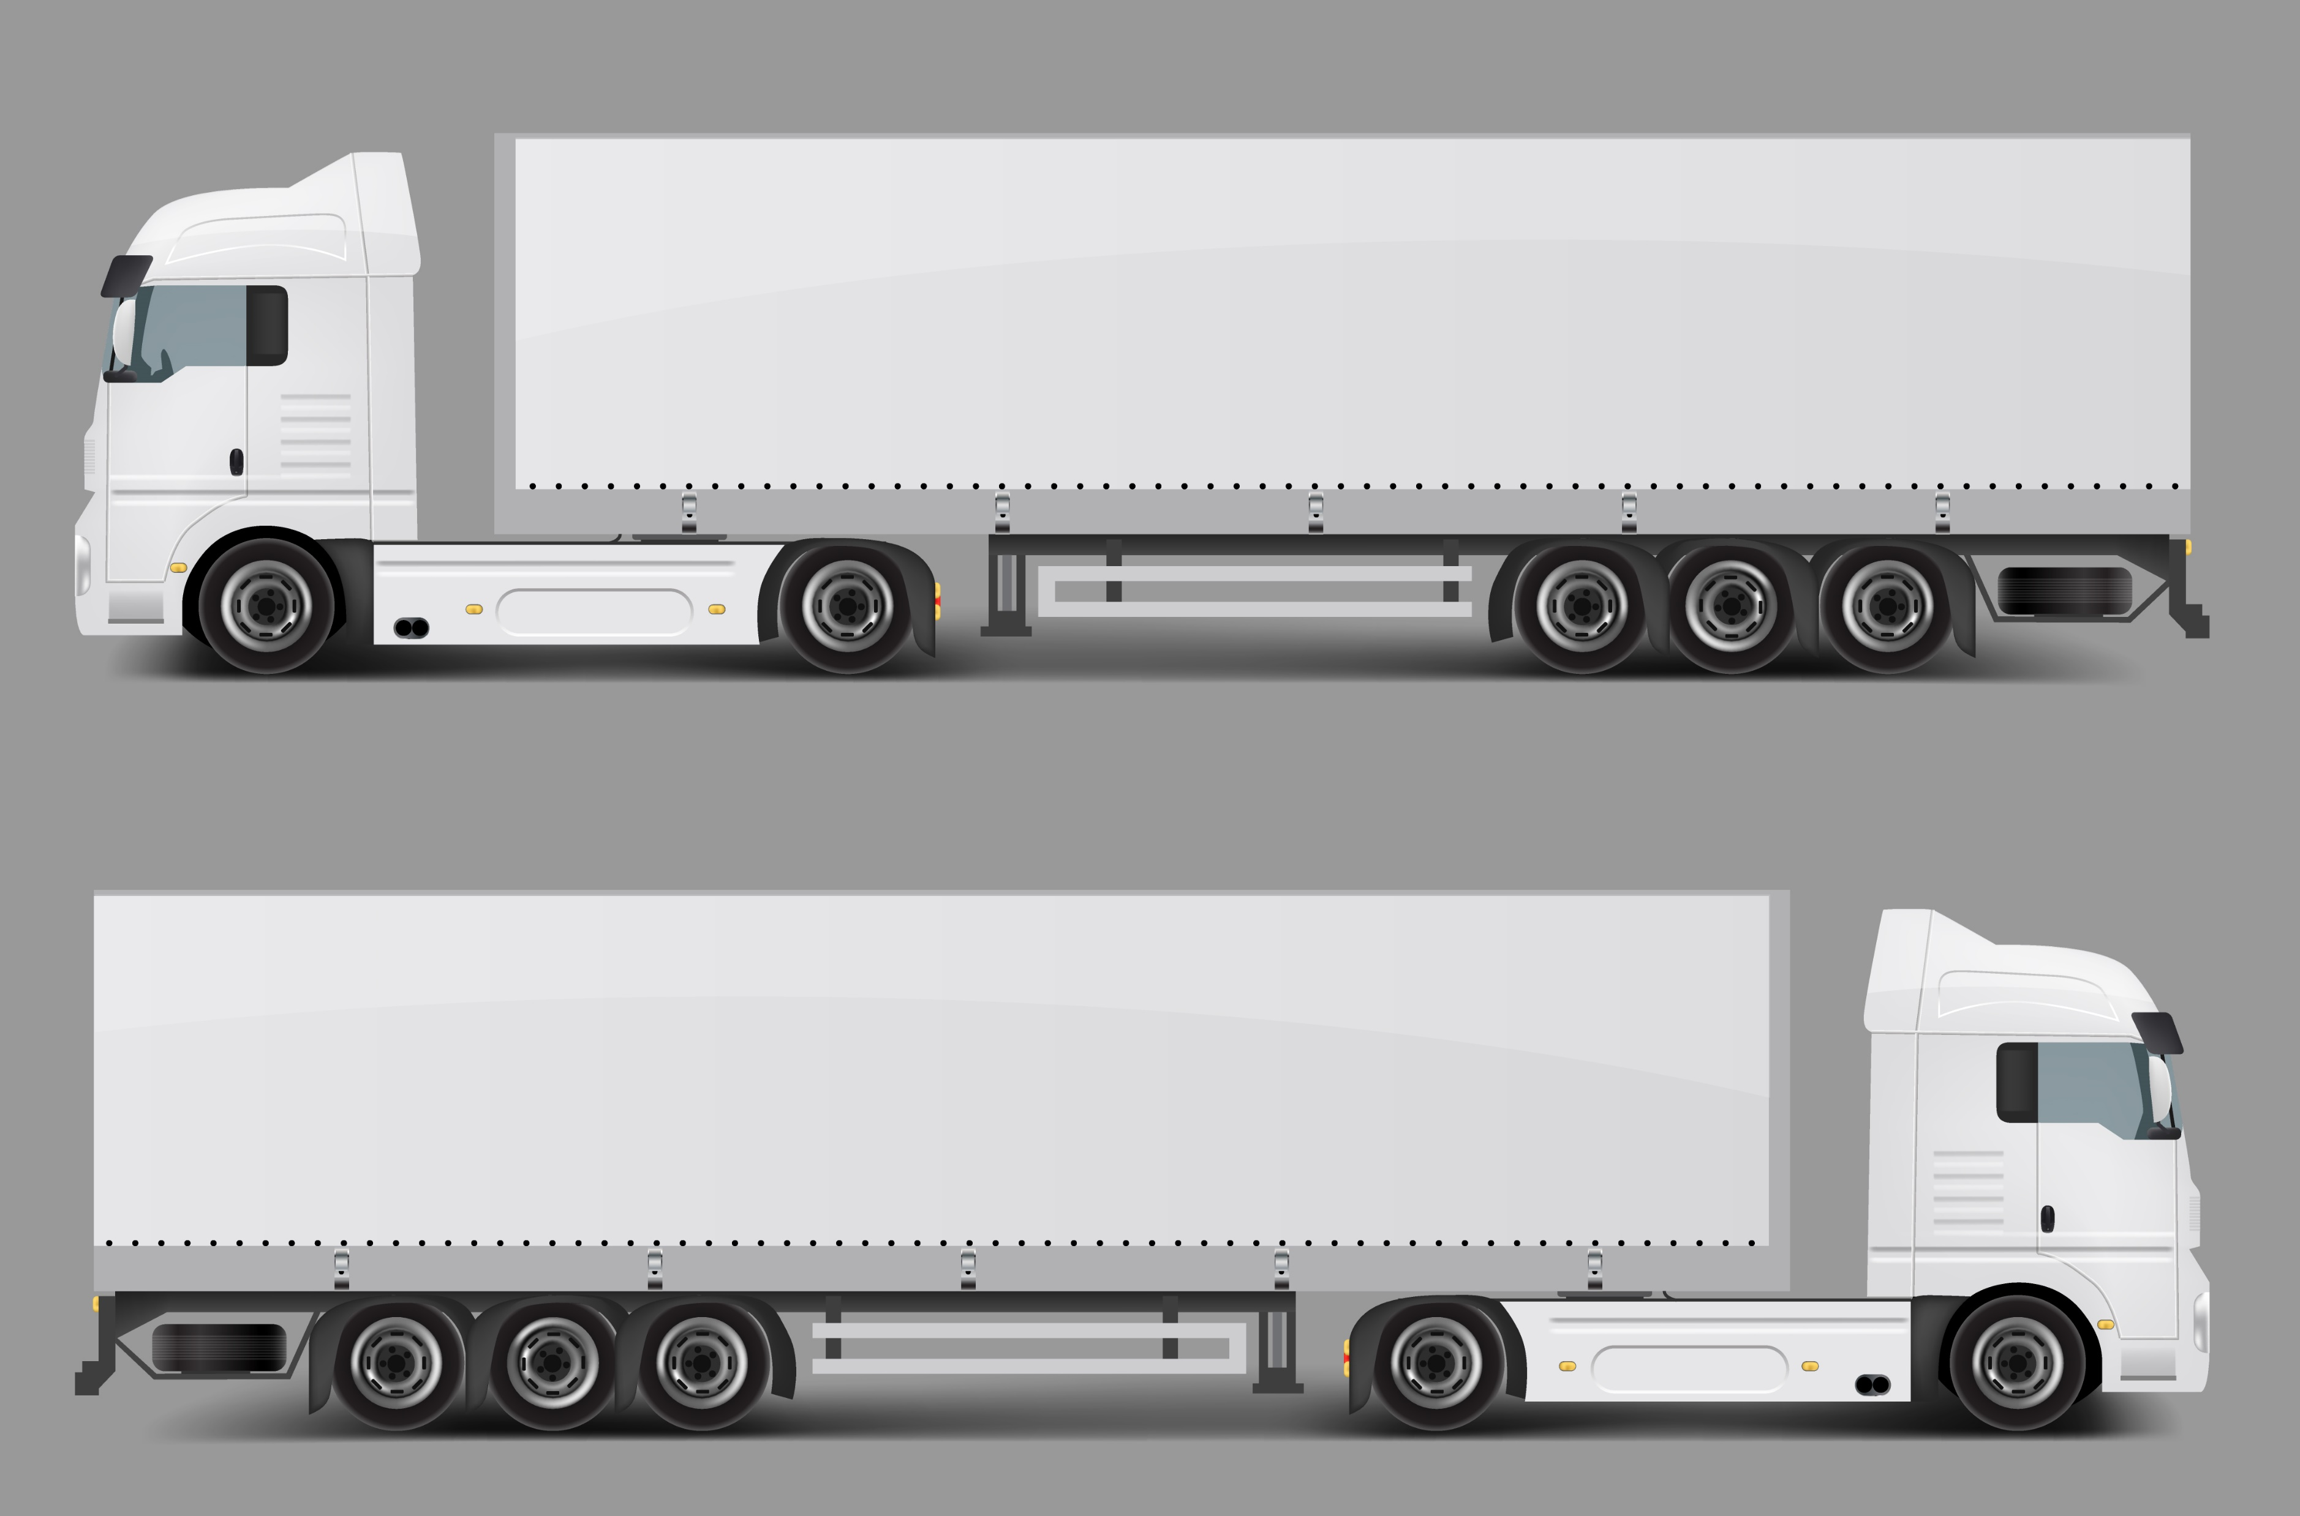
AUTOMOTIVE SYSTEMS ENGINEERING PROJECT
TEAM
INTELLION
4AT100 – TEAM 02
ARYAN KUMAR
LUUK THELEN
ADWAITH GOPICHAND
AMIT GALI
SAI KIRUTHEKA PERAM
MARIEN DEN BESTEN

Slide 2
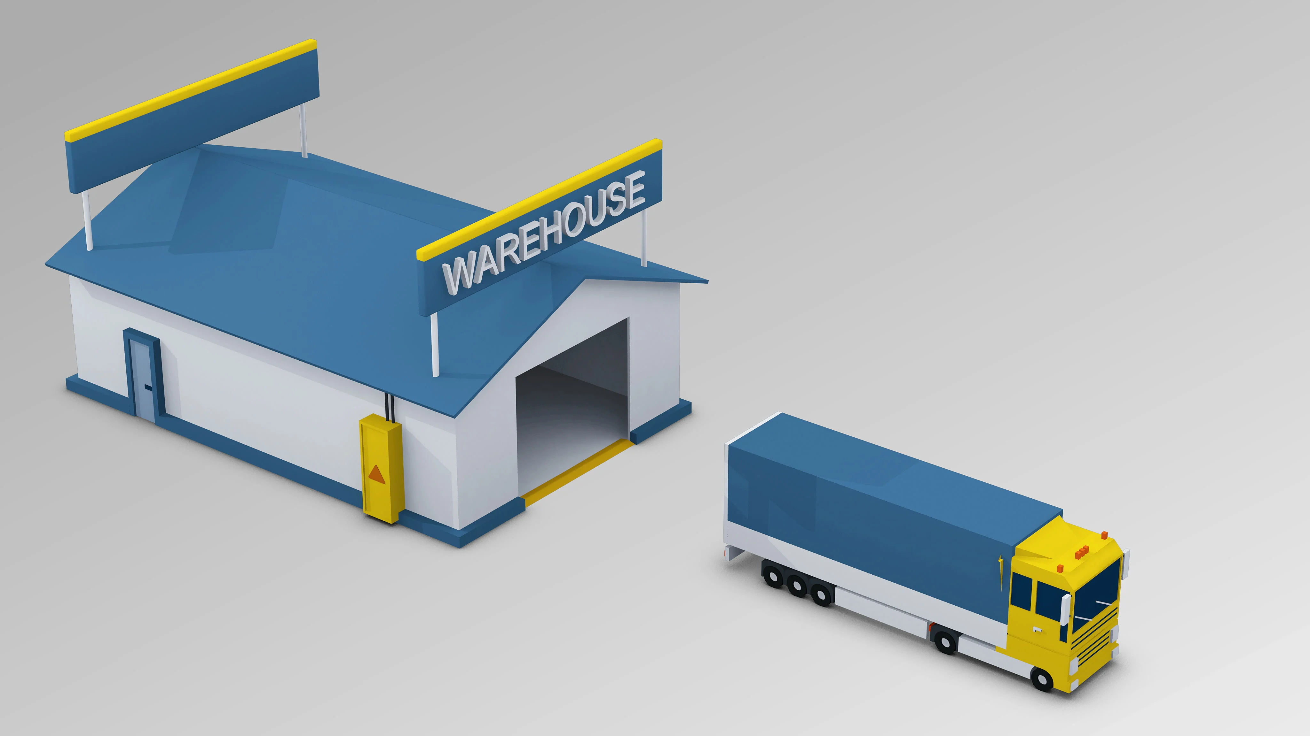
CONTENT
The challenge
ARHITECTURE
THE IDEA
IMPLEMENTATION
Outcome
Limitations
Future work

Slide 3
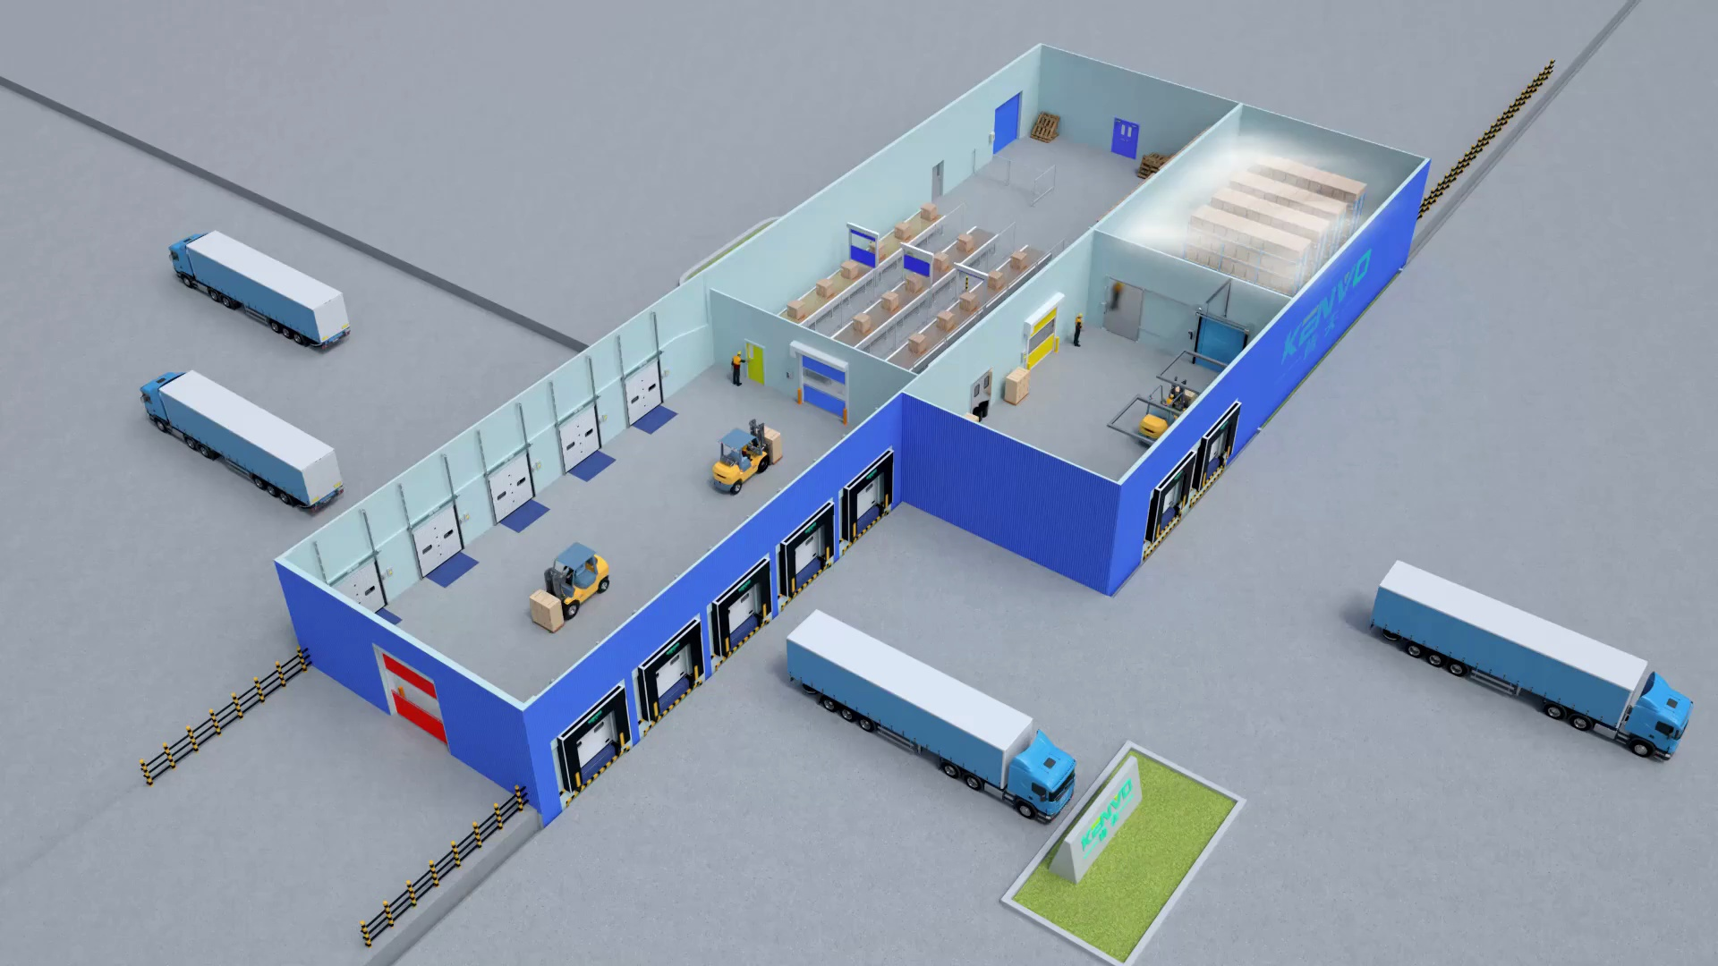
The challenge
The current distribution centers cannot keep up with the rising demand
Increased fatalities in the distribution centers.
Ever increasing concerns for cost, safety, efficiency, emissions - climate change and global warming
The solution
To implement Digital Twin Autonomous Driving Truck System in Distribution Center

Slide 4
OBJECTIVE
Develop digital twin
Prototyping
Real time data storage
CONTROL SYSTEM
DC Level
Truck Level
AUTONOMOUS DRIVING TRUCKS
Steering, Accelerating and Braking
HMI – Driver Monitoring
Object Detection

Slide 5
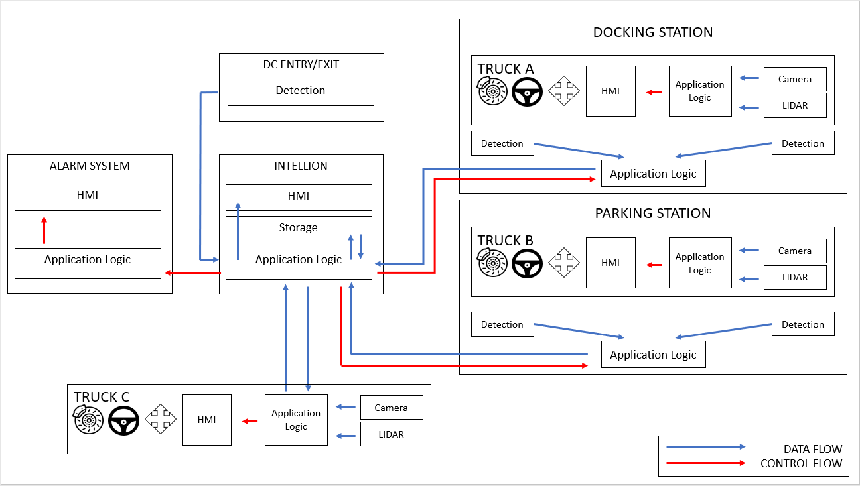
architecture
5

Slide 6
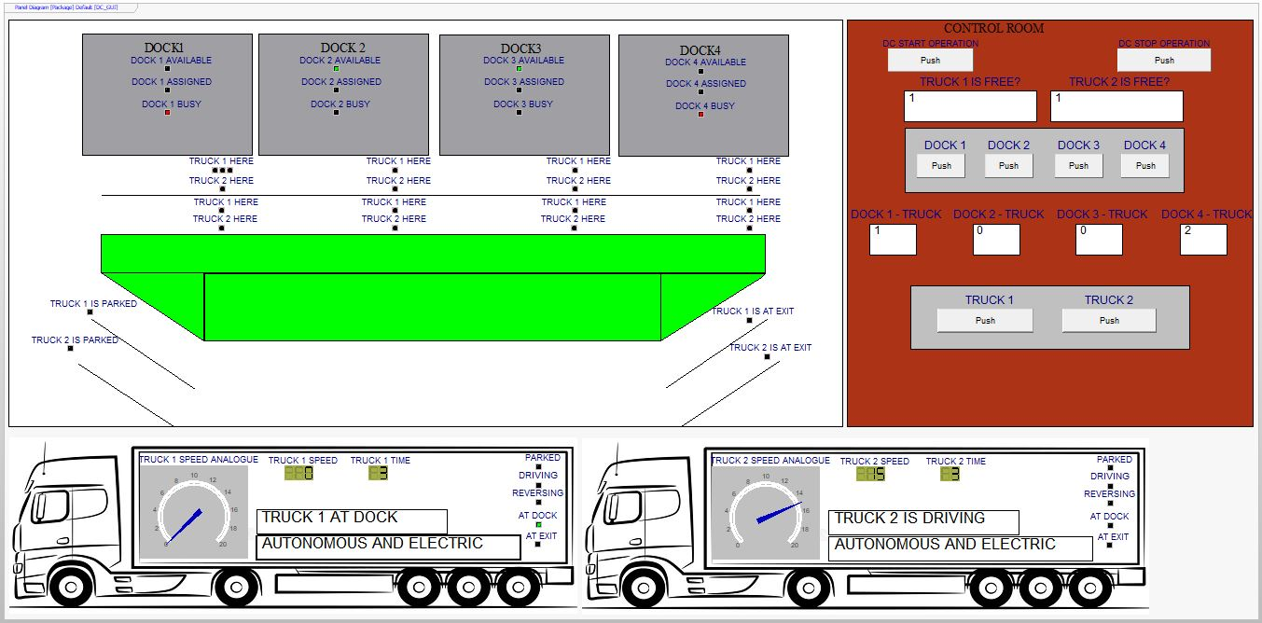
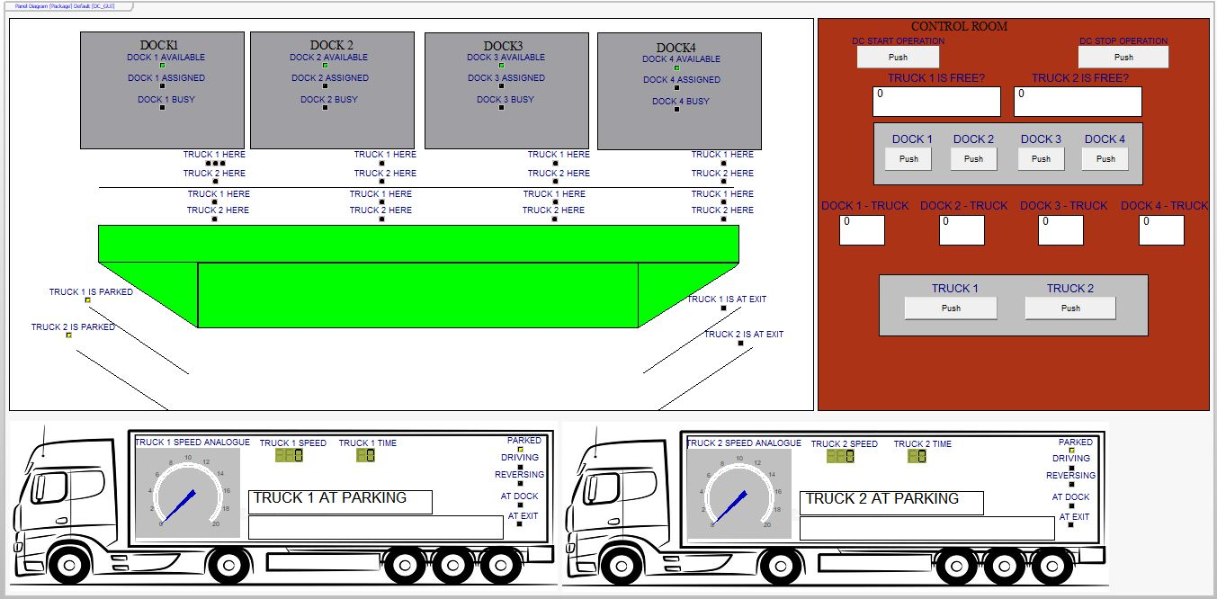
The plan
6

Slide 7
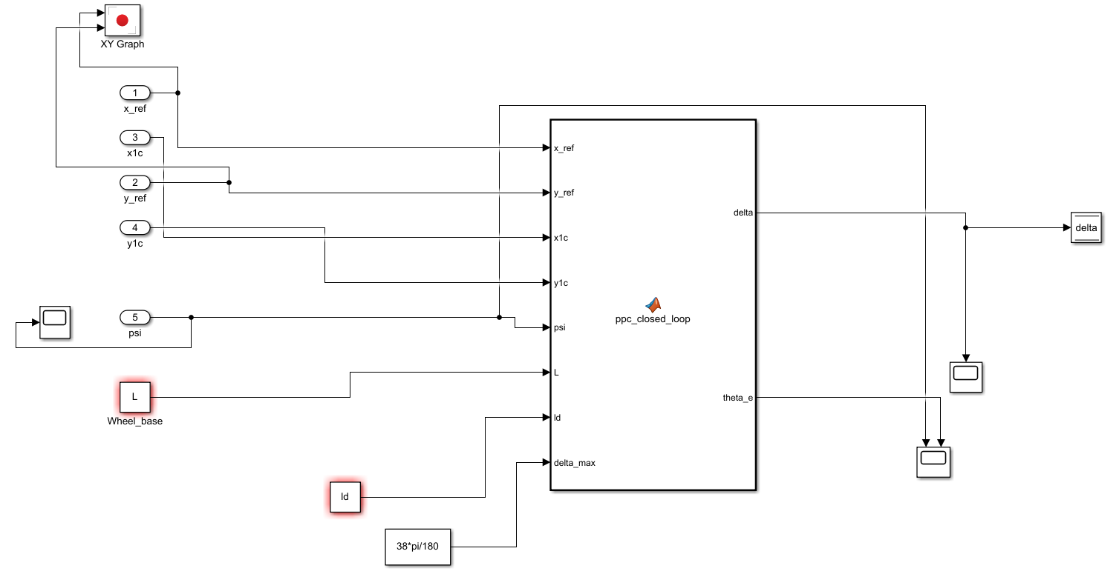
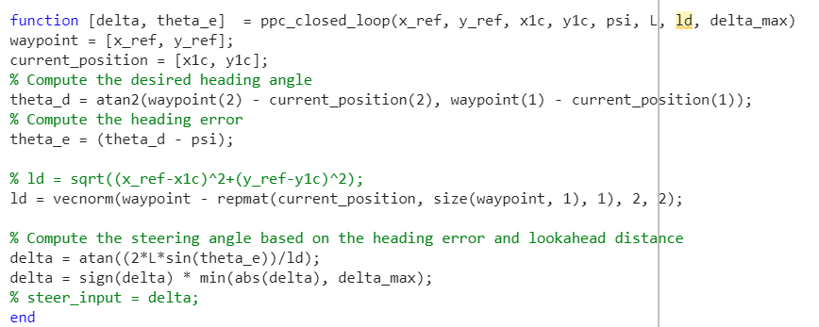
Implementation – motion controller
7
Contribution to the whole 4AT100 Group Project:
Forward Motion Controller
Type of controller: Pure Pursuit
Inputs:
X and Y coordinates of the rear axle
X and Y coordinates from the reference path
Vehicle heading angle (psi)
Wheelbase
Look Ahead distance value
Maximum steering angle limit
Outputs:
Required Steering angle
Heading angle error

Slide 8
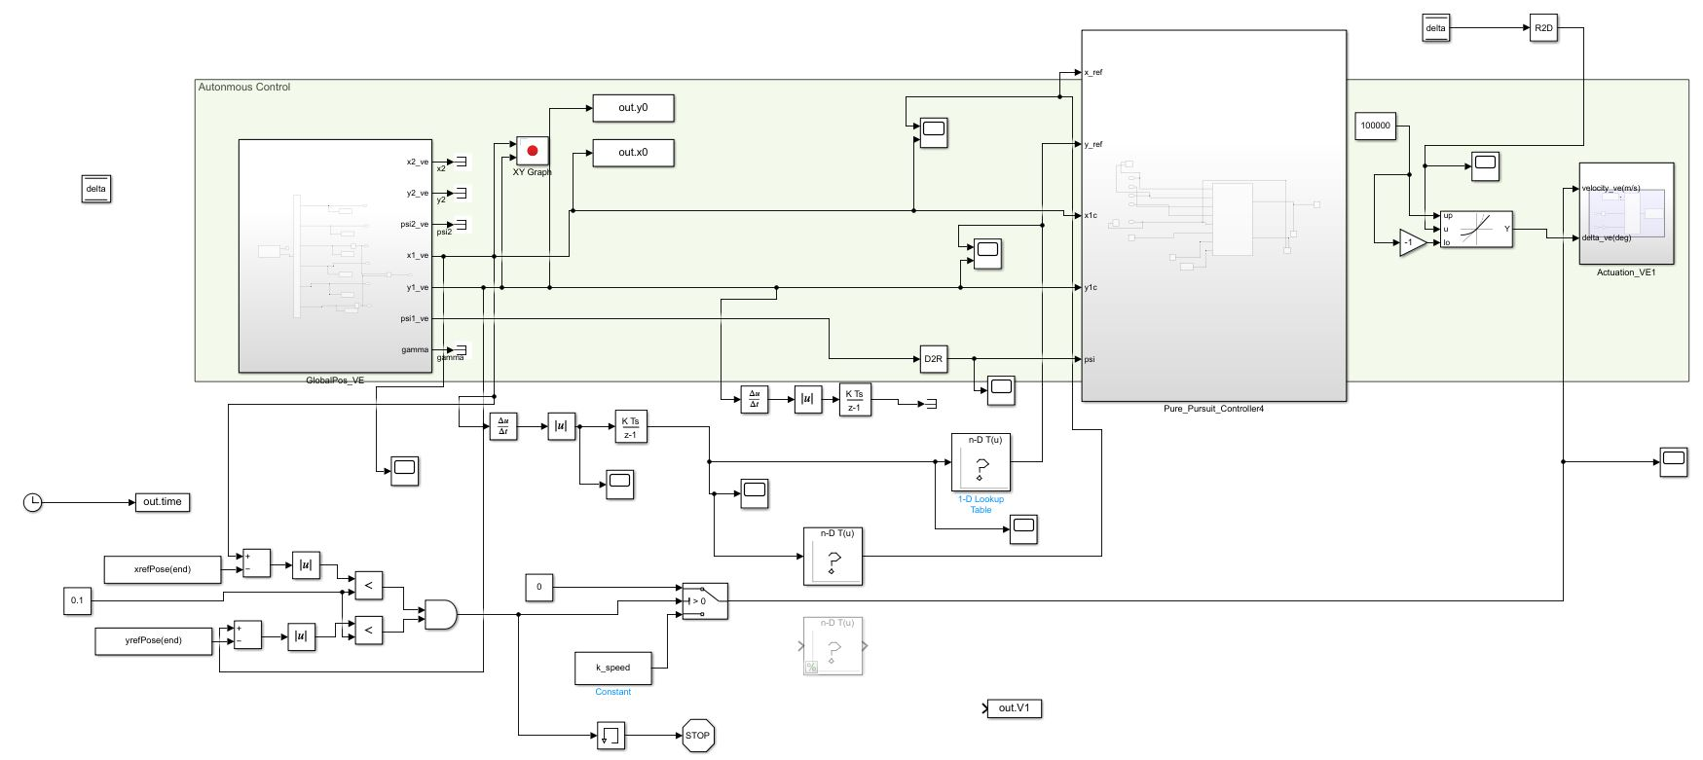
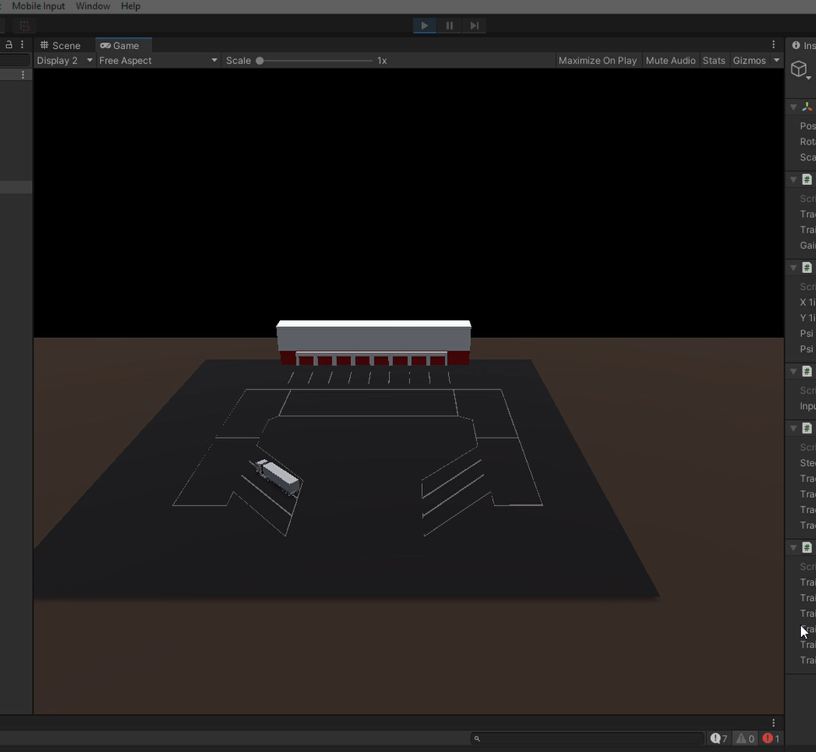
Implementation – VIRtual testing
8
Simulink Model
Unity Game Engine

Slide 9
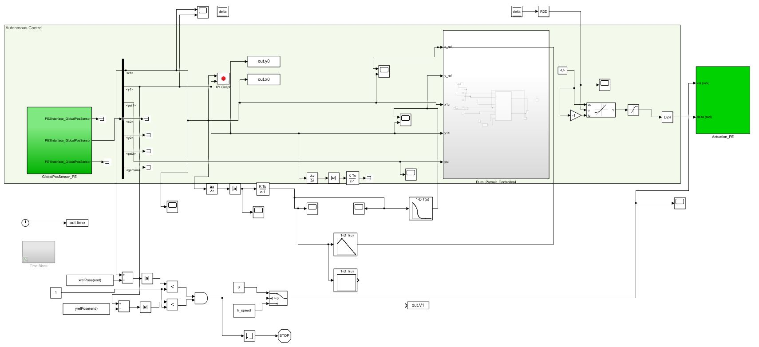
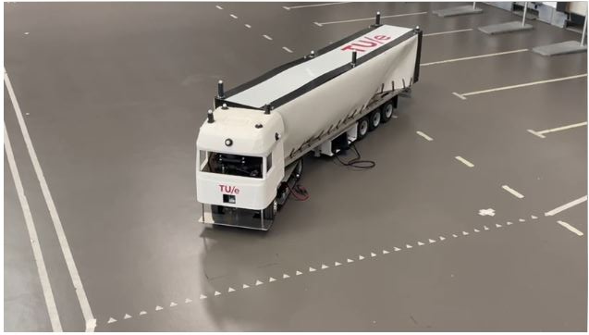
Implementation – Physical testing
9
Simulink Model
Physical Truck

Slide 10
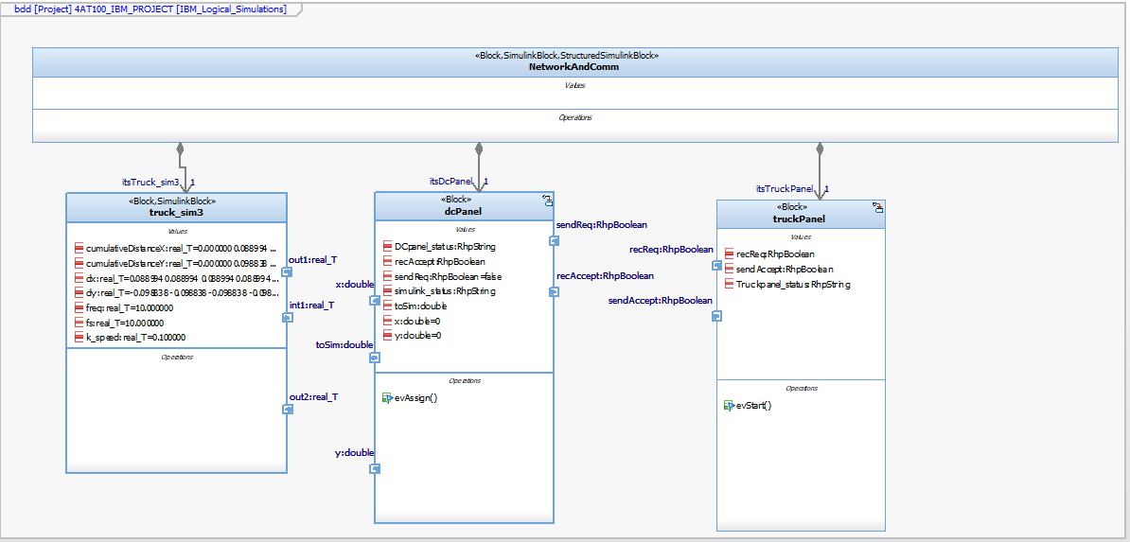
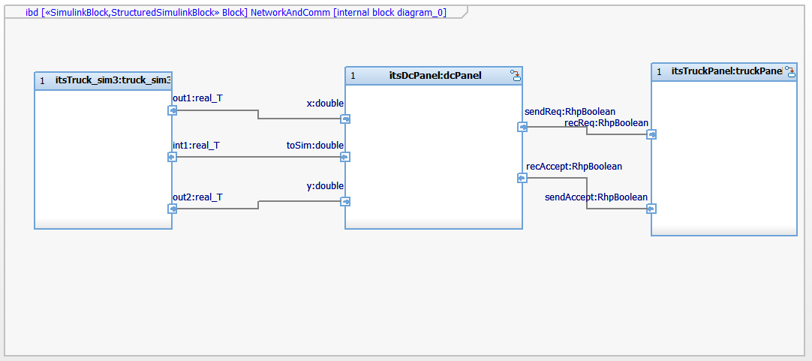
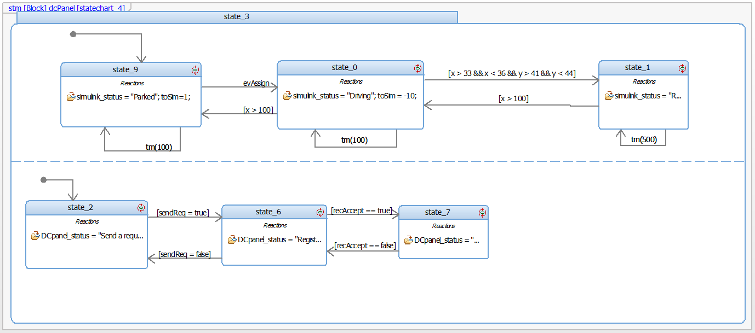
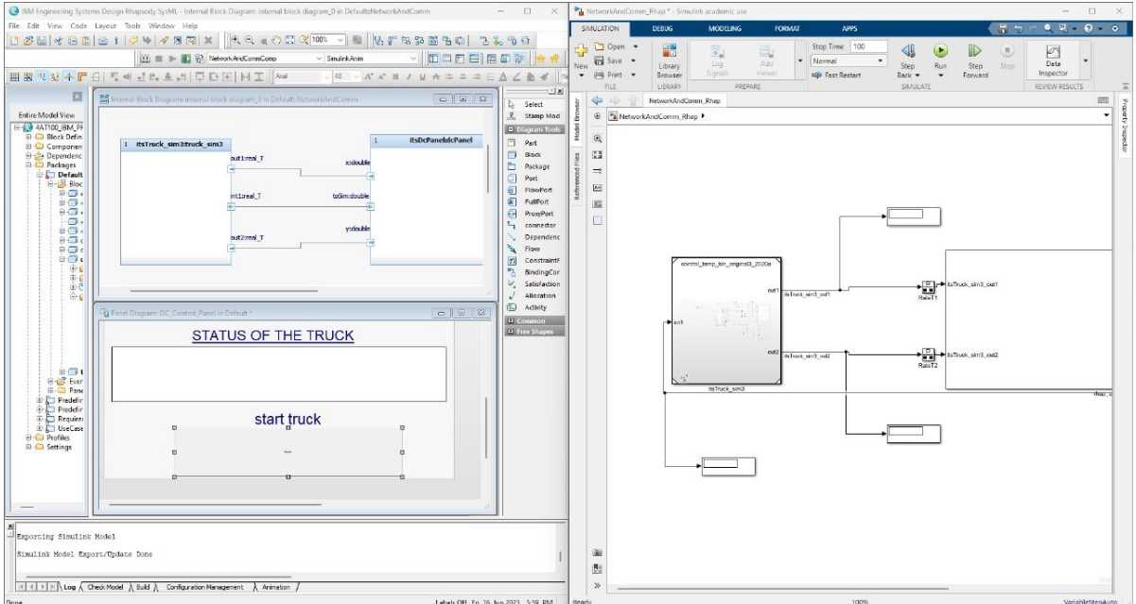
Implementation - integration
10
IBM Rhapsody
Simulink

Slide 11
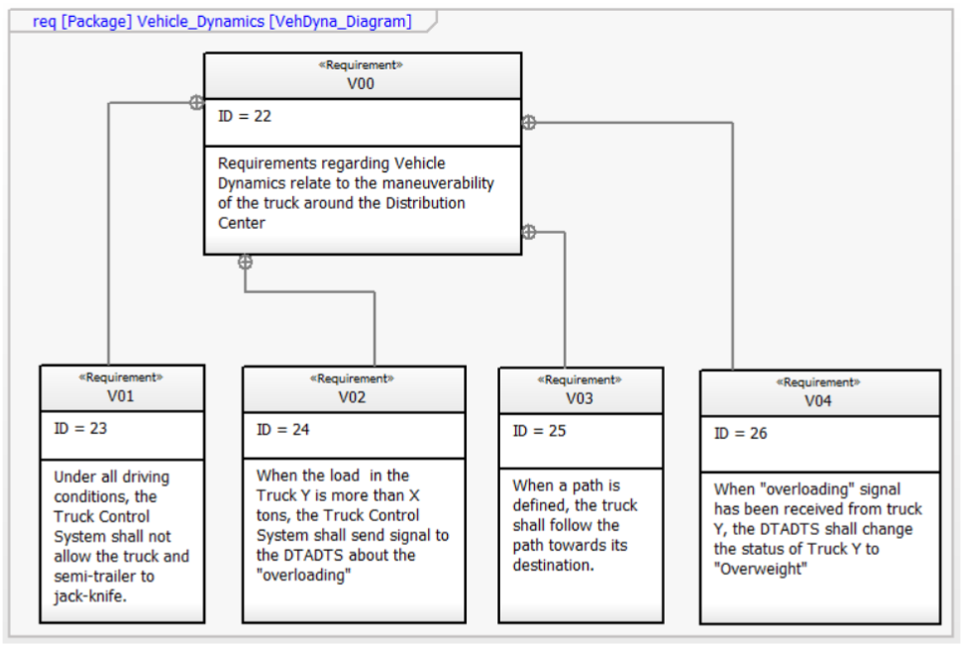
CONCLUSION AND outcome
11
Requirement Analysis
Acceptance Testing
System Analysis
System Testing
Architecture Design
Integration Testing
Unit Design
Unit Testing
Implementation

Slide 12
limitations
12
HMI was not developed
Reverse Motion Controller was not designed/developed
The integration was very basic
Complete System Simulation was not possible
Knowledge Gap on Object Detection and Avoidance

Slide 13
Future work
13
Collaborate with other teams to design Reverse Controller and HMI
Continue working on the Integration
Acquire Knowledge on Object Detection and Avoidance
Try to successfully run the whole system level simulation

Slide 14
Thank you

